Slide 1




Group No. : S9 - 4
RFID & RF BASED E-VOTING SYSTEM
Presented By:-
1. Tejas Kole – E2301
2. Harsh Kolhe – E2302
3. Tejas Kotgire – E2304
4. Shraddha Kshirsagar – E2306
Department of Electronics & Telecommunication Engineering
Smt. Kashibai Navale College of Engineering, Pune - 41.
Guided By:-
Prof. Archana Deokate
SKNCOE SE (E&TC) 2024-25

Slide 2
Aim and Objectives
Abstract
Literature Review
Introduction
Block Diagram
Circuit Diagram
Results
References
CONTENTS
SKNCOE SE (E&TC) 2024-25

Slide 3
AIM
>> To develop an electronic voting system using RFID and RF modules for secure and contactless voting.
>> To utilize the ESP32 microcontroller for processing and WiFi-based connectivity.
>> To design a portable and compact hardware prototype integrated with buttons, LCD display, LEDs, and a buzzer.
>> To store voting data in real-time to Google Sheets via Apps Script Web App.
>> To eliminate manual errors, fake votes, and duplicate entries through RFID-based identification.
>> To enhance transparency, reliability, and efficiency in small-scale organizational elections.
SKNCOE SE (E&TC) 2024-25

Slide 4
OBJECTIVES
•To uniquely identify each voter using RFID cards or tags, ensuring secure and authorized access.
•To interface the RFID module (RC522) with ESP32 for card scanning and UID detection.
•To integrate buttons representing different political parties (BJP, INC, AAP, NOTA) for casting votes.
•To provide real-time feedback to voters using LEDs, buzzer, and a 16x2 I2C LCD display.
•To enable vote casting timeout and invalid card handling using custom logic in Arduino code.
•To implement master/admin RFID card functionality for ending voting and displaying the result.
•To display vote summary and winner on both the LCD and send it to a Google Sheet via WiFi
.
•To prevent multiple voting from the same card by tracking already-voted users.
•To improve user-friendliness with LCD instructions, countdowns, and error handling.
•To demonstrate a functional prototype simulating real-time secure voting suitable for small-scale organizations.
SKNCOE SE (E&TC) 2024-25

Slide 5
ABSTRACT
🔹 This project presents an RFID & RF Based E-Voting System designed to ensure secure and transparent elections by preventing fraud and duplicate voting.
🔹 It uses an ESP32 microcontroller with an RC522 RFID scanner, buttons for party selection, LEDs, buzzer, and a 16x2 LCD for real-time feedback.
🔹 Voters scan their RFID cards to authenticate and vote once. Votes are sent live to a Google Sheet via WiFi.
🔹 A Master RFID card ends voting and shows the final summary with the winner. The system includes invalid card alerts, duplicate vote prevention, auto timeout, and visual feedback.
🔹 Ideal for internal elections in institutions or organizations as a reliable, tamper-proof prototype.
SKNCOE SE (E&TC) 2024-25

Slide 6
LITERATURE REVIEW
S.N. | Year | Title | Methodology
1 ) | 2017 | RFID-Based Electronic Voting Machine with Secure Access | Proposed a secure voting system using RFID cards to authenticate voters and restrict duplicate voting.
2 ) | 2019 | IoT-Enabled E-Voting System Using ESP32 and Cloud Integration | Integrated ESP32 with RFID and Google Sheets to store votes in real time and visualize data.
3 ) | 2020 | Multi-Level Authentication E-Voting System Using RFID & Biometrics | Combined fingerprint recognition with RFID card scanning to ensure high-level identity validation.
4 ) | 2021 | Secure RFID Voting System with Blockchain-Based Result Storage | Used blockchain ledger to store votes submitted via RFID-based validation, ensuring tamper-proof results.
5 ) | 2023 | Real-Time IoT-Based Voting with LCD Feedback and Remote Monitoring | Enabled live feedback via LCD and remote result monitoring using WiFi and cloud-based spreadsheets.
SKNCOE SE (E&TC) 2024-25

Slide 7
INTRODUCTION
• In today’s digital era, the need for modernization of conventional voting systems is crucial. Traditional methods involve manual registration, paper-based ballots, and physical counting, which are often time-consuming, error-prone, and susceptible to manipulation or malpractices. These limitations highlight the importance of building a secure, automated, and efficient voting mechanism.
• The RFID & RF Based E-Voting System is designed to address these challenges by leveraging RFID technology for voter authentication and ESP32 with WiFi connectivity to transmit and store votes in real-time to a Google Sheet. Each voter is issued an RFID tag, which when scanned, verifies their identity. Once verified, the voter casts their vote using dedicated buttons for each party. The system ensures that every user votes only once and prevents duplication through backend verification. Moreover, administrators can access real-time vote summaries and winner announcements, making the system transparent and auditable.
•This smart system enhances reliability, reduces manual labor, eliminates the need for paper, and offers cloud-based storage — making it ideal for institutions, organizations, or small-scale elections.
SKNCOE SE (E&TC) 2024-25

Slide 8
WHY ?
• To eliminate manual errors and improve the accuracy of vote recording.
• To prevent fraudulent voting, such as double voting or unauthorized access.
• To enable real-time data logging and winner calculation on Google Sheets.
• To provide a cost-effective and portable solution for small-scale voting needs.
• To provide a cost-effective and portable solution for small-scale voting needs.
• To familiarize students with practical applications of RFID, IoT, and embedded systems.
• To introduce a modern voting system that is secure, fast, and eco-friendly.
• To demonstrate how technology can enhance transparency and trust in the election process.
SKNCOE SE (E&TC) 2024-25

Slide 9

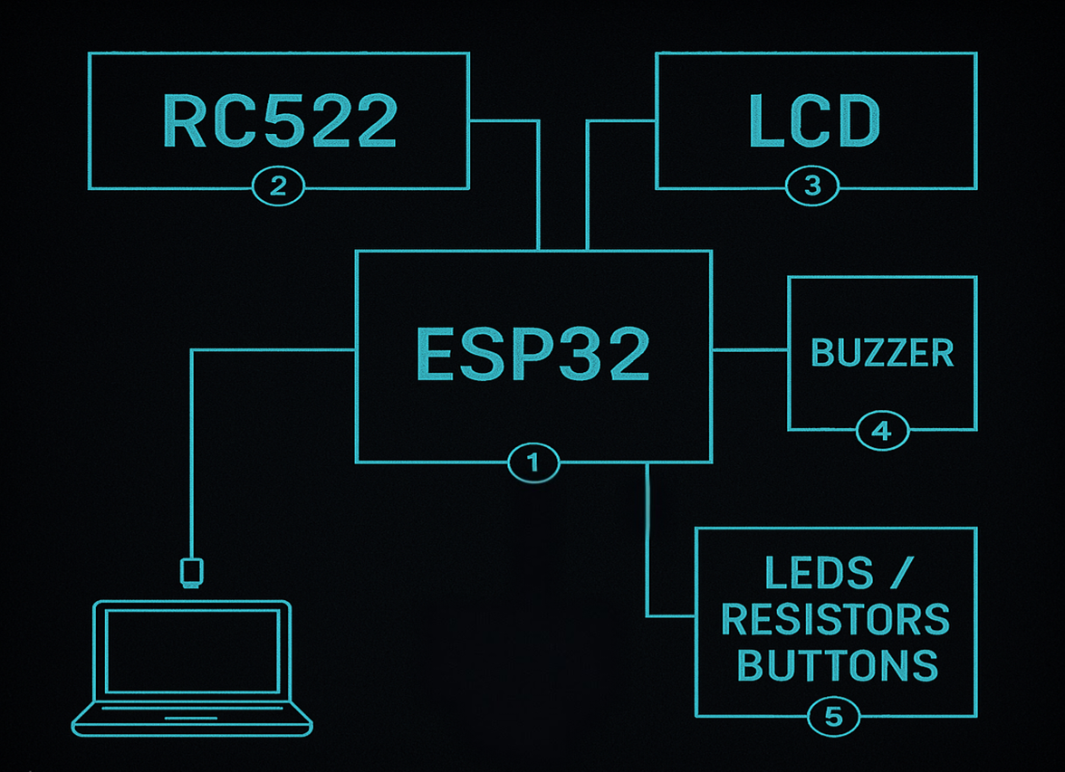
BLOCK DIAGRAM
SKNCOE SE (E&TC) 2024-25

Slide 10
EXPLANATION / TABLE
Block Name | Discription
ESP32 | Acts as the central controller of the system. It manages RFID input, voting logic, LED/buzzer feedback, LCD output, and real-time Google Sheet logging via WiFi.
RC522 (RFID Reader) | Scans RFID cards to identify and authenticate voters using unique UIDs, allowing only authorized users to vote.
LCD (16x2 I2C Display) | Displays messages like scan status, voter name, vote confirmation, countdown timer, and final winner summary.
Buzzer | Provides audio feedback for card scans, invalid entries, vote success, or admin card detection.
LEDs / Resistors / Buttons | Buttons: Represent voting options (e.g., BJP, INC, AAP, NOTA). LEDs: Blink to indicate a successful vote. Resistors: Ensure proper current flow and component safety.
Laptop via USB | Used for powering the ESP32, uploading code, and monitoring serial output for testing/debugging.
SKNCOE SE (E&TC) 2024-25

Slide 11
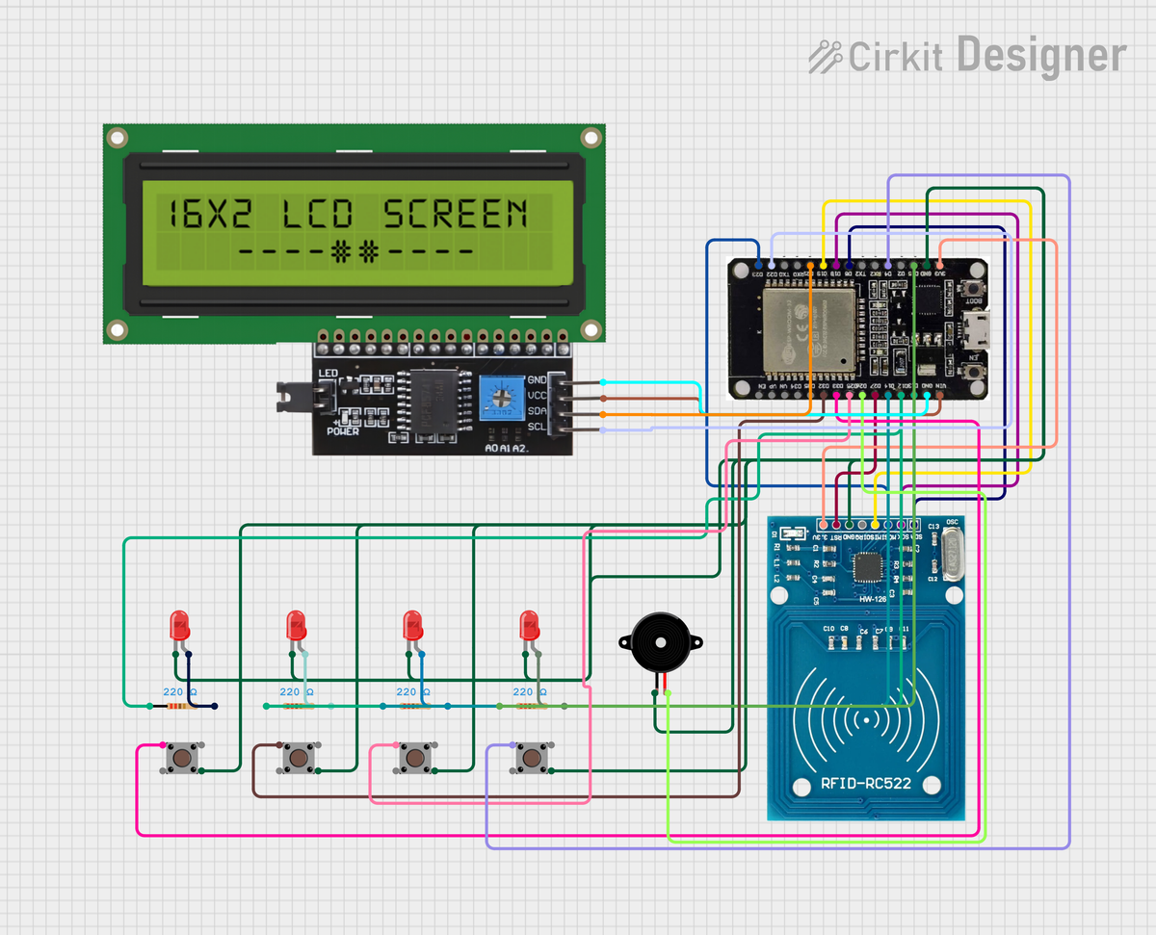
CIRCUIT DIAGRAM
SKNCOE SE (E&TC) 2024-25

Slide 12
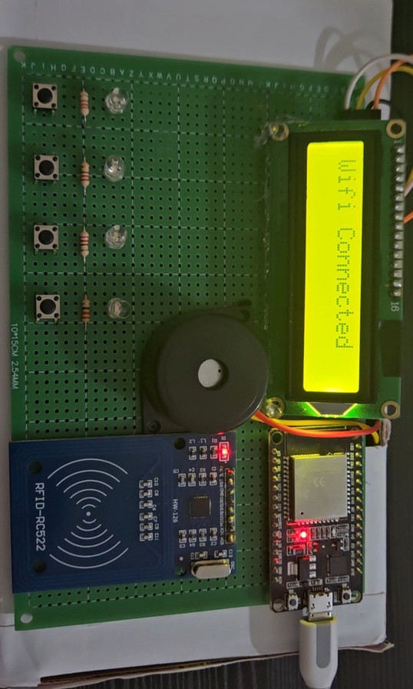
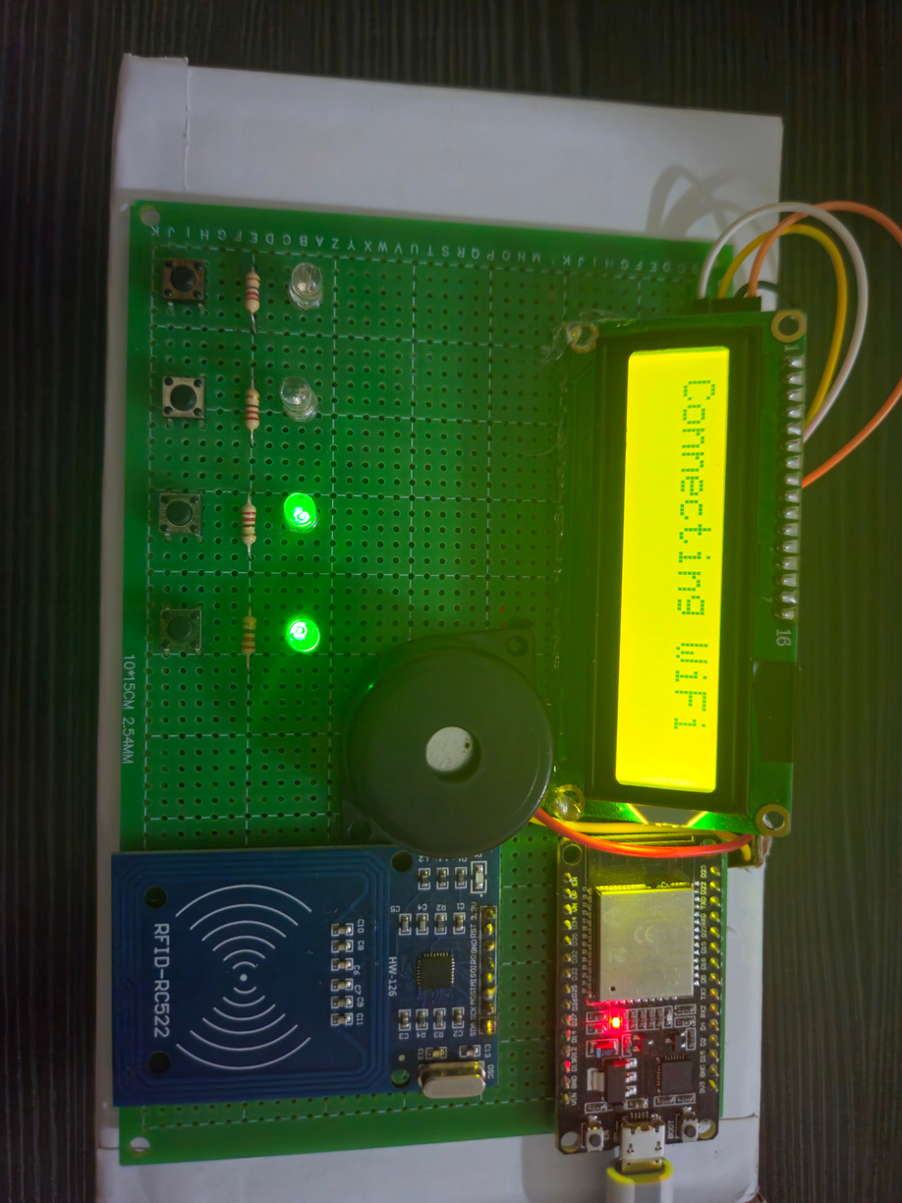

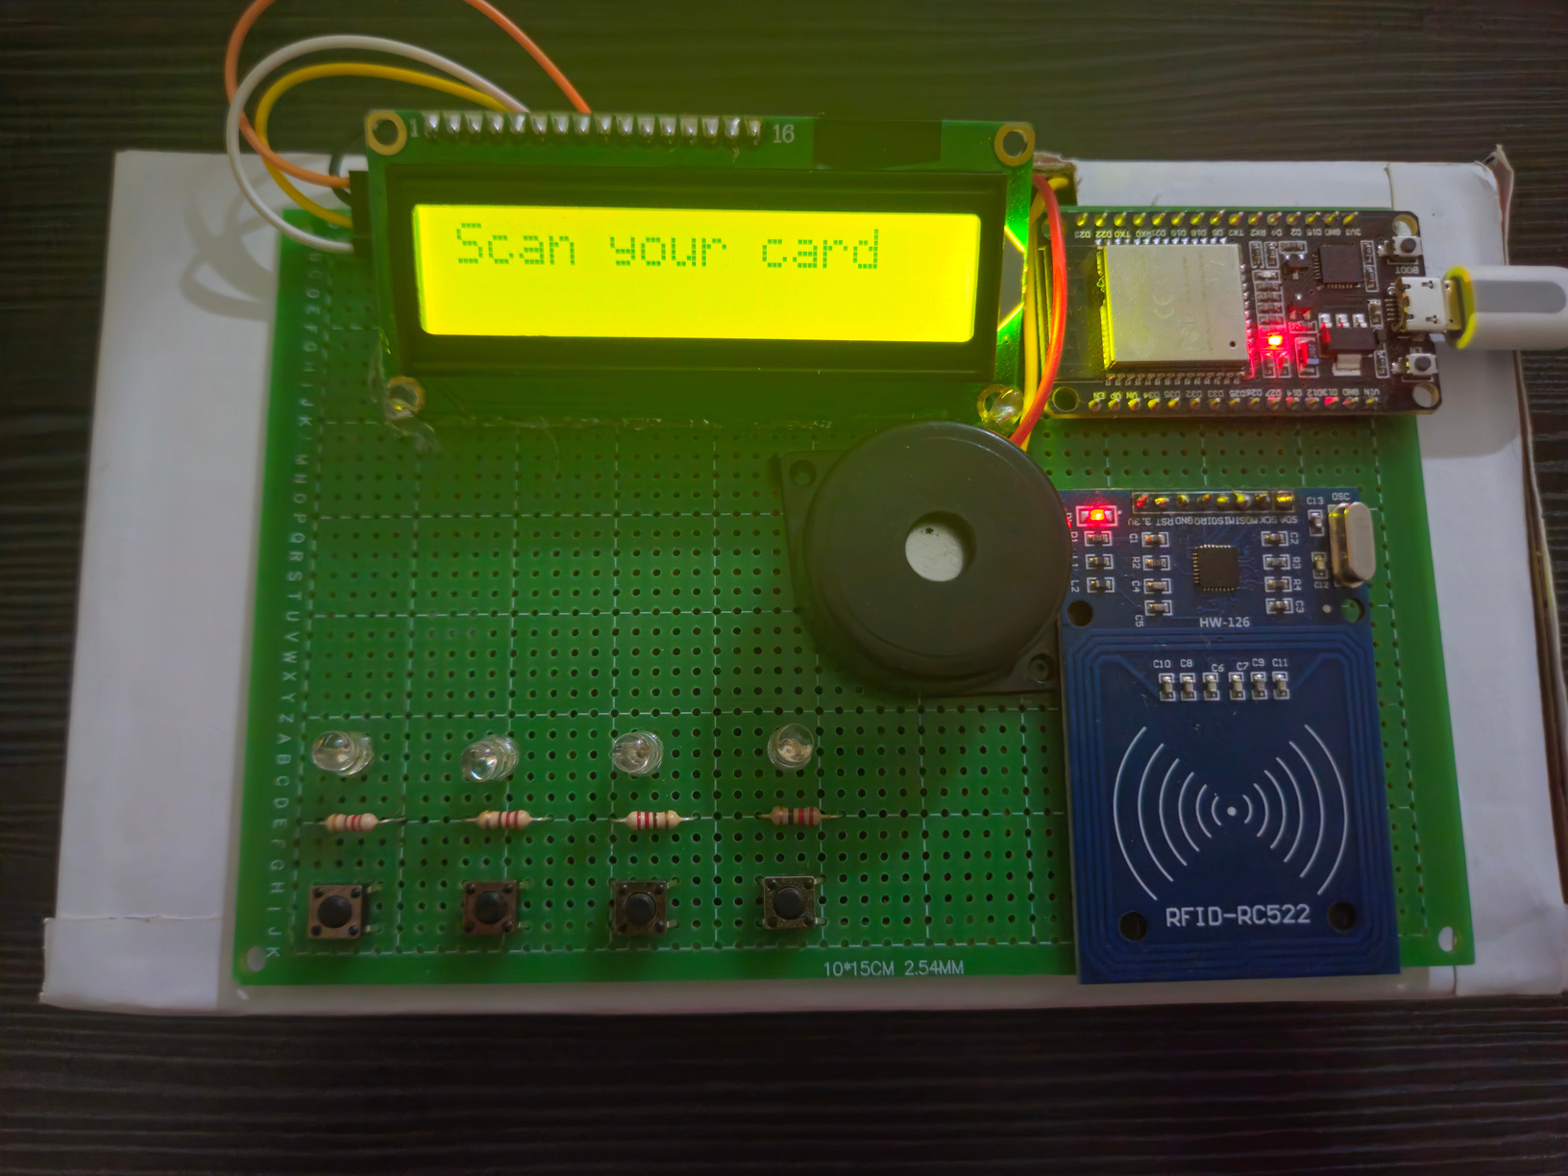
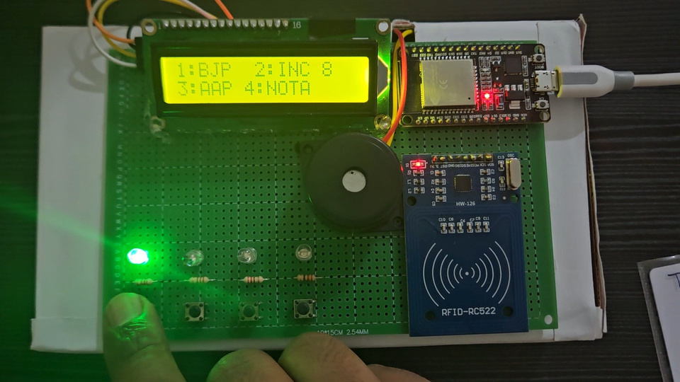
RESULTS (WORKING IMAGES)
page 05

Slide 13
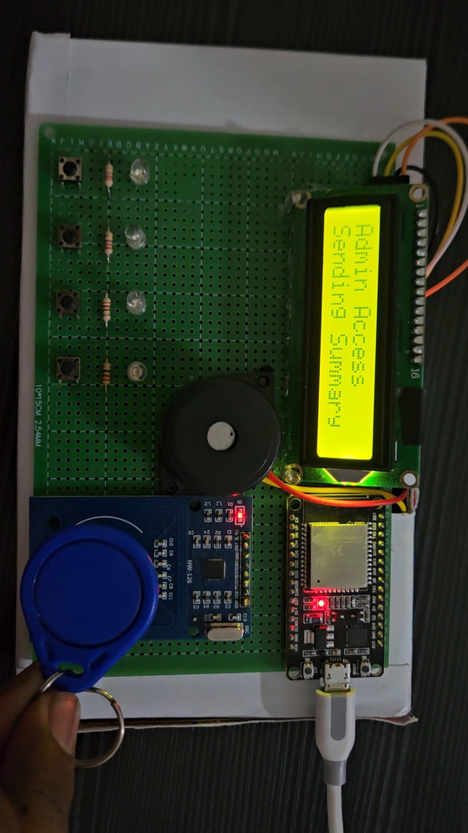
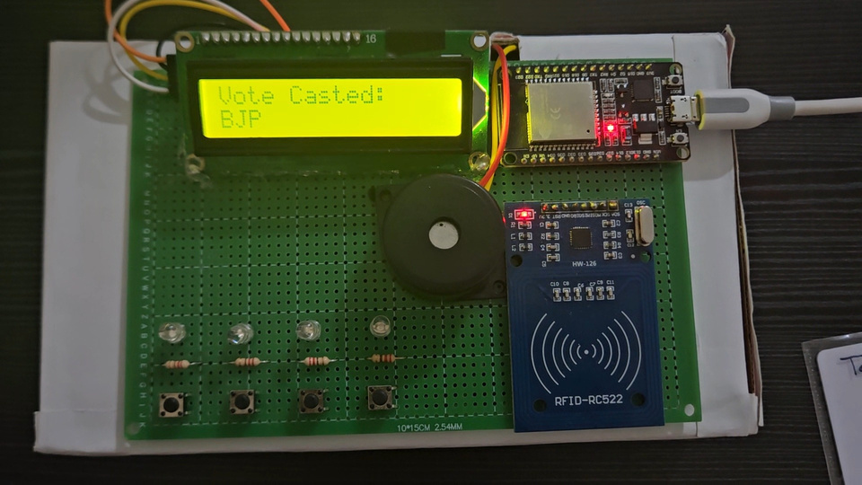
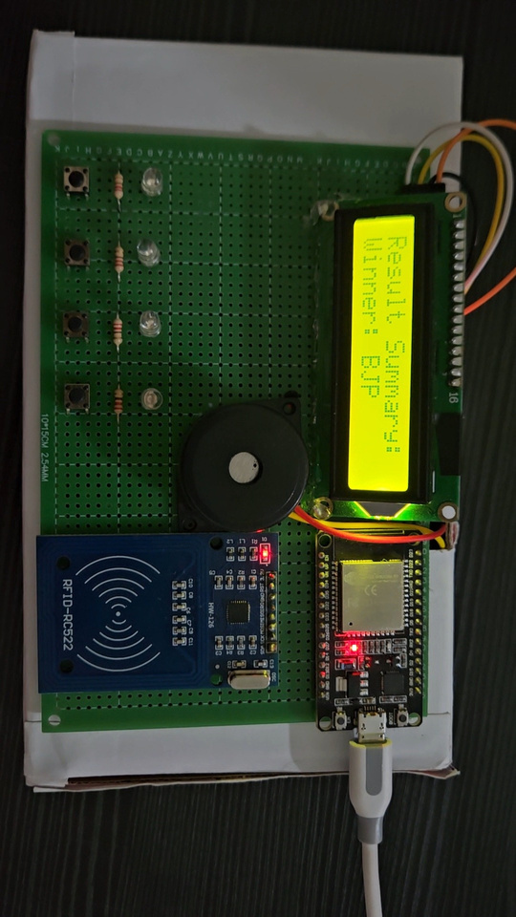
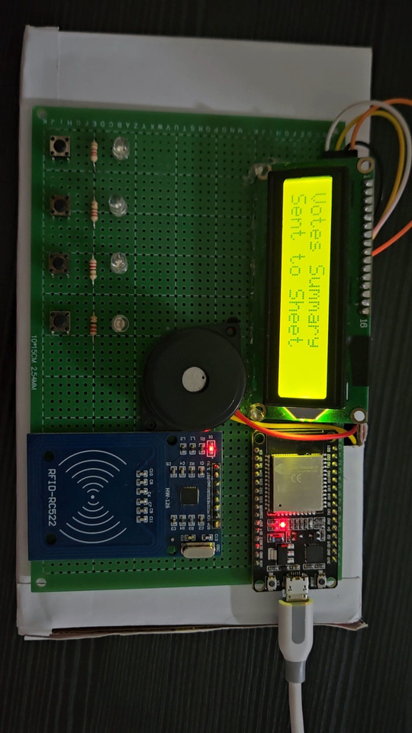
RESULTS (WORKING IMAGES)
page 05

Slide 14
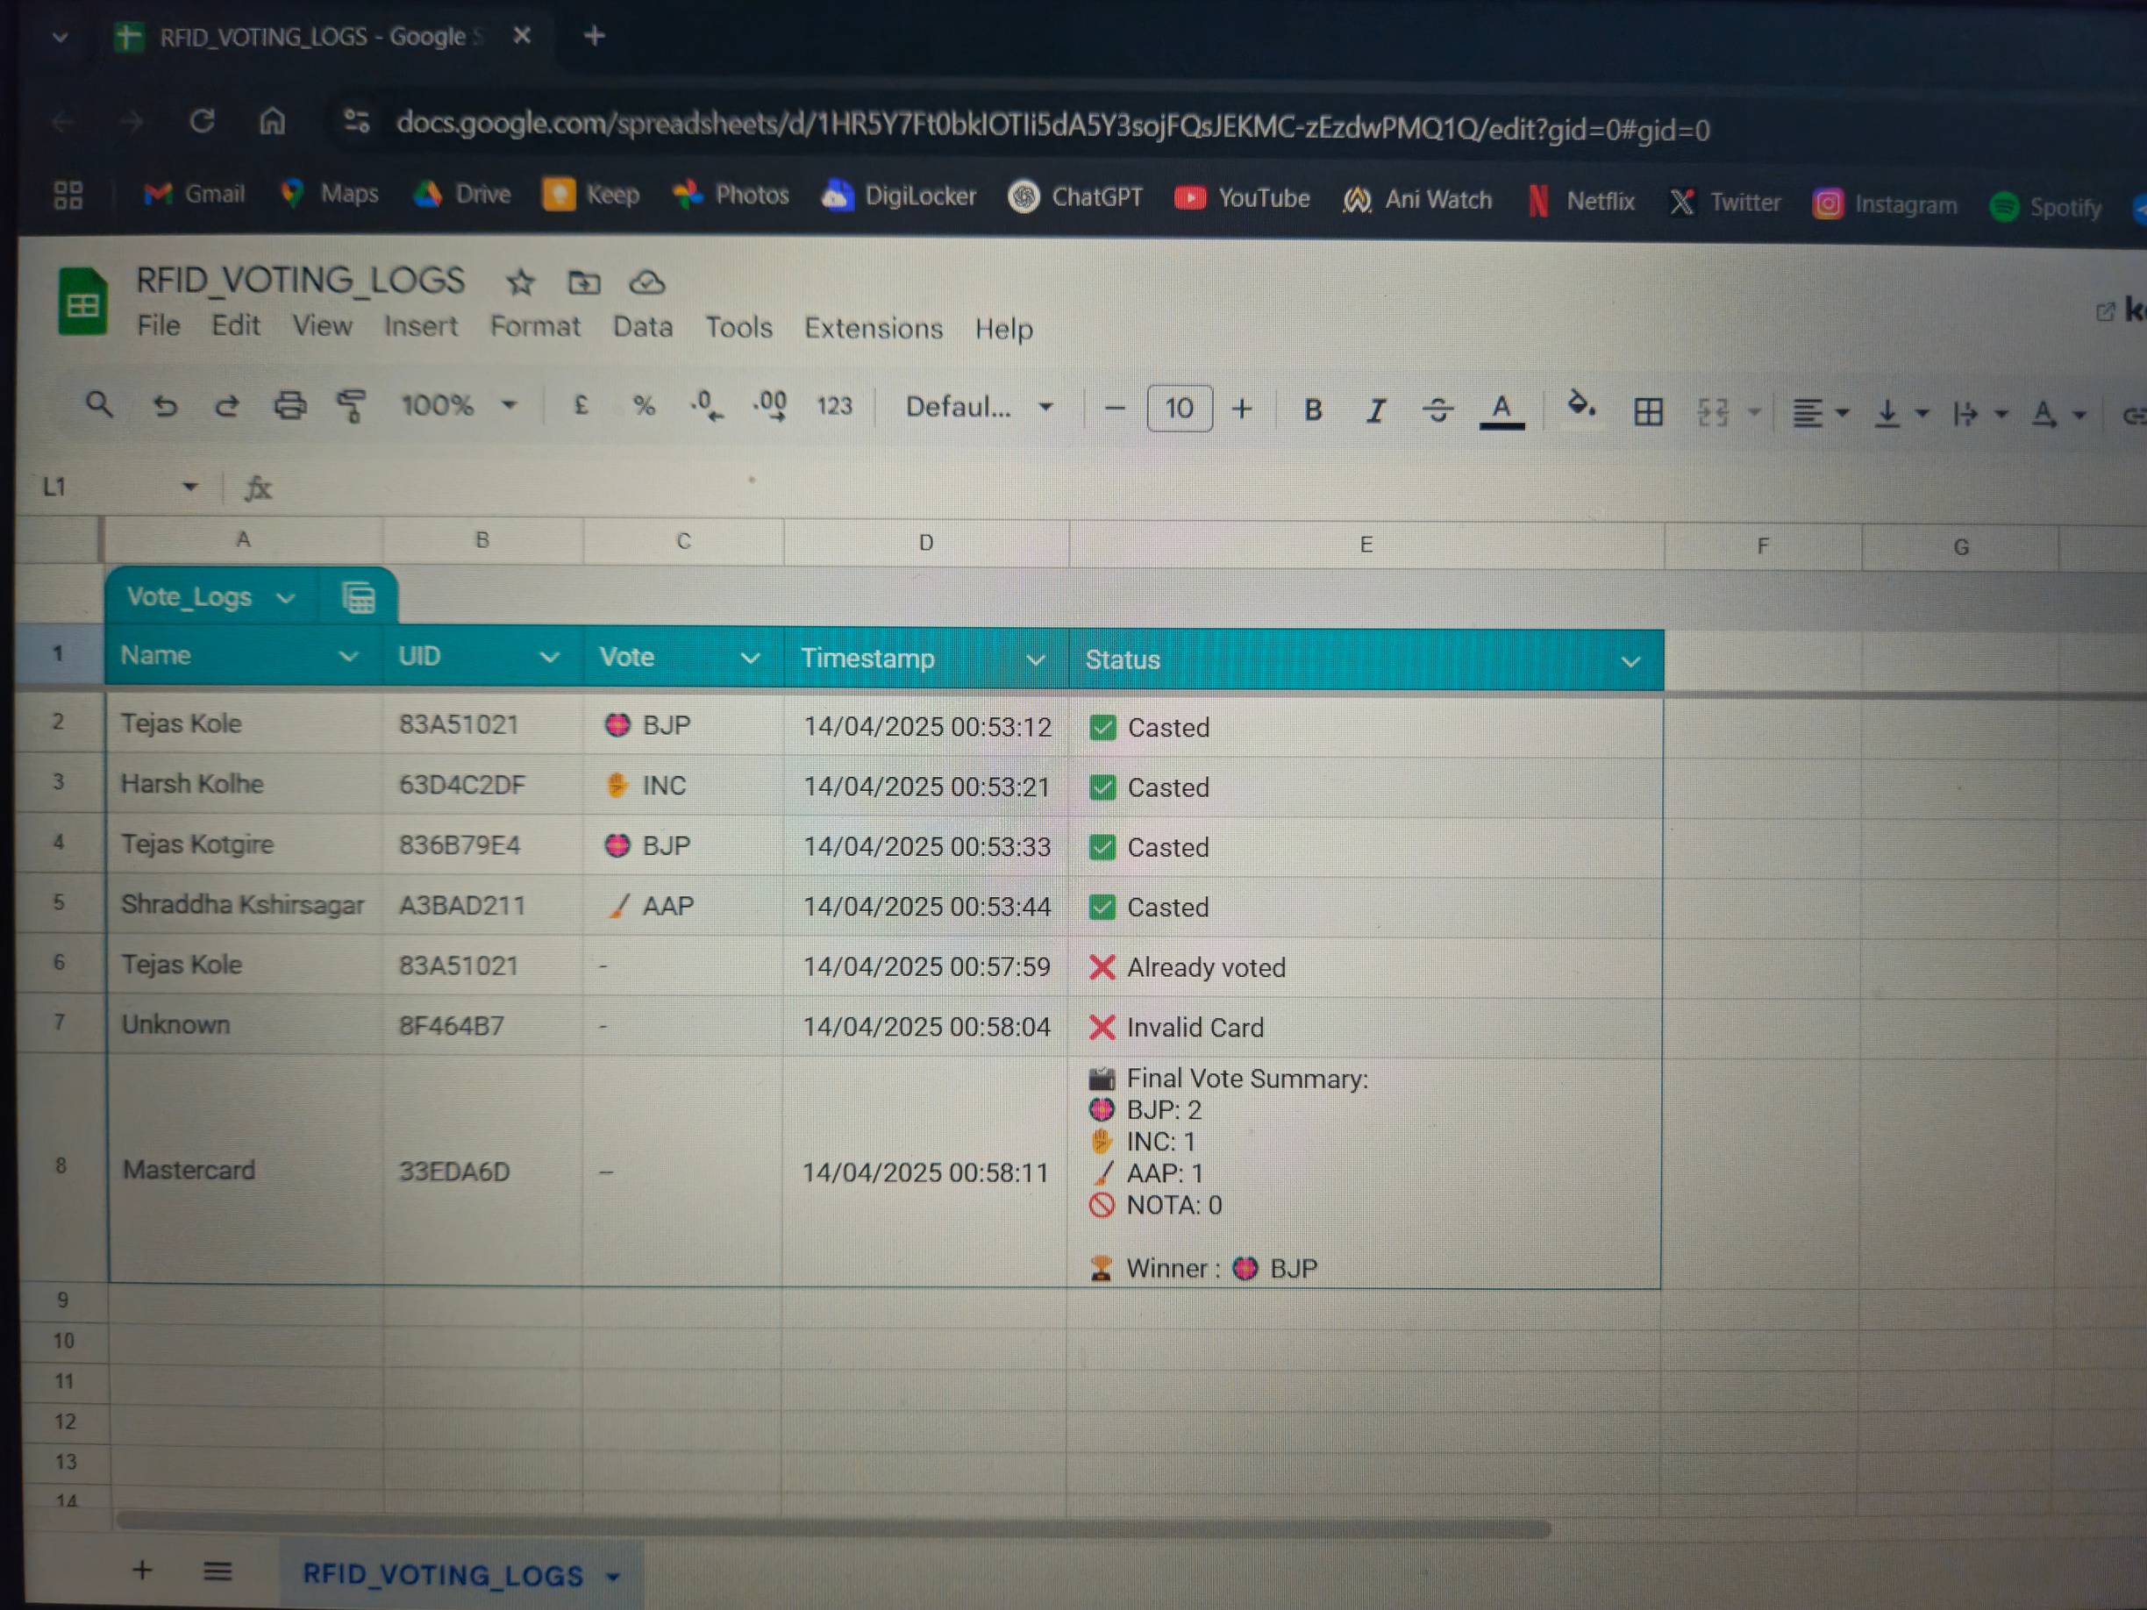
RESULTS (WORKING IMAGES)
page 05

Slide 15
CONCLUSION
➤ Ensures secure, transparent, and tamper-proof voting
➤ Uses RFID cards to allow only registered voters
➤ Prevents duplicate votes with one-person-one-vote logic
➤ Logs votes in real-time to Google Sheets for transparency
➤ Master card shows total votes and winner on LCD and sheet
➤ Handles tie cases, no votes, and invalid cards smartly
➤ Includes 10-second timeout to keep the system responsive
➤ Provides LED and buzzer feedback for better user interaction
➤ Can be extended with biometrics or IoT dashboard
SKNCOE SE (E&TC) 2024-25

Slide 16
REFERENCES
➤ Rajeshwari Sundararajan, “Microcontroller-Based Electronic Voting Machine”, IJESI, Vol. 2, Issue 2, 2013
➤ Klaus Finkenzeller, RFID Handbook: Fundamentals & Applications in Smart Cards, RFID, and NFC
➤ D. L. Chaudhari, “Smart Electronic Voting Machine Using RFID”, IRJET, Vol. 5, Issue 4, 2018
➤ MFRC522 RFID Module Datasheet, NXP Semiconductors
➤ ESP32 Technical Reference Manual, Version 4.0, Espressif Systems
➤ LiquidCrystal_I2C Library Documentation, Arduino.cc
➤ Google Apps Script Documentation, script.google.com
➤ William Stallings, Wireless Communications & Networks
➤ Arduino.cc Community Forums & Official Library Repositories
➤ IEEE Xplore Digital Library – Research on secure RFID-based systems
SKNCOE SE (E&TC) 2024-25

Slide 17

THANK YOU !
Github
Youtube
Drive

